Slide 1
Elysium Mons
Isidis Basin
Gale Crater

Slide 2
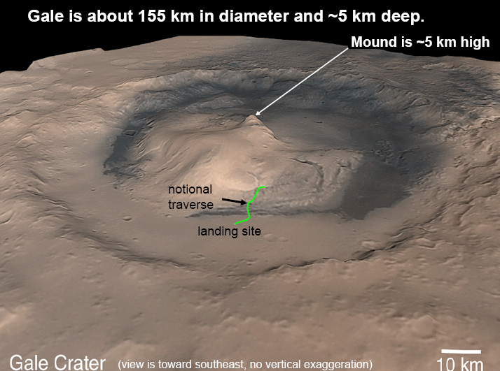

Slide 3
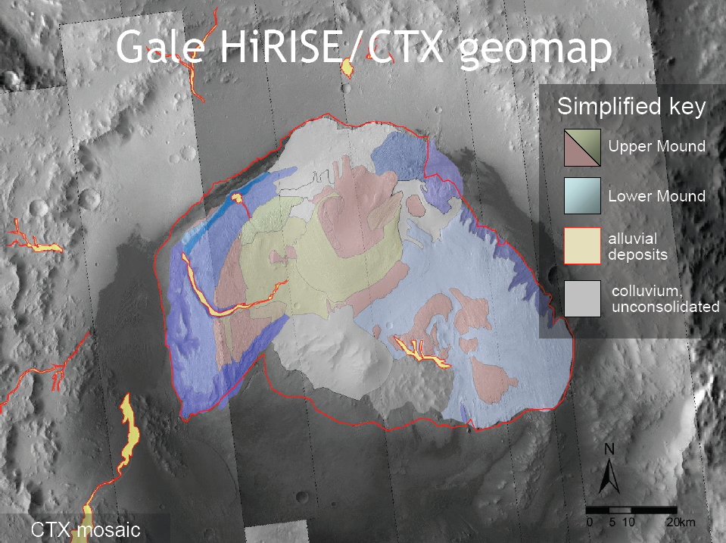
Landing Ellipse
Traverse

Slide 4
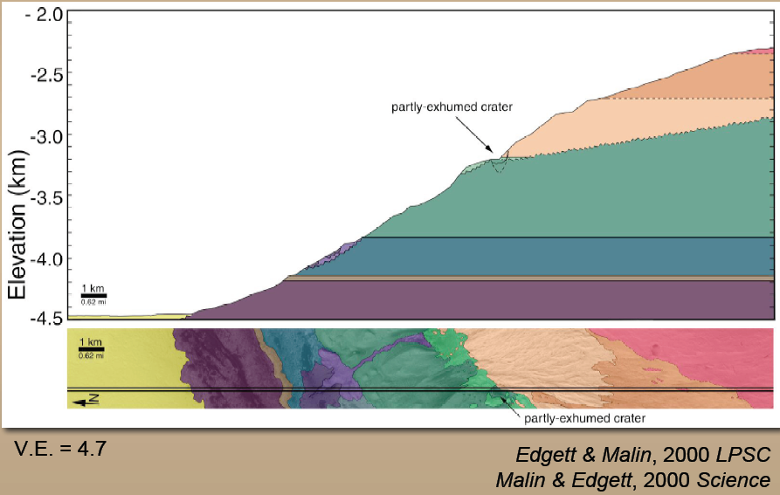
Gale Crater
Central Mount Stratigraphy
Upper Unit
Lower Unit

Slide 5
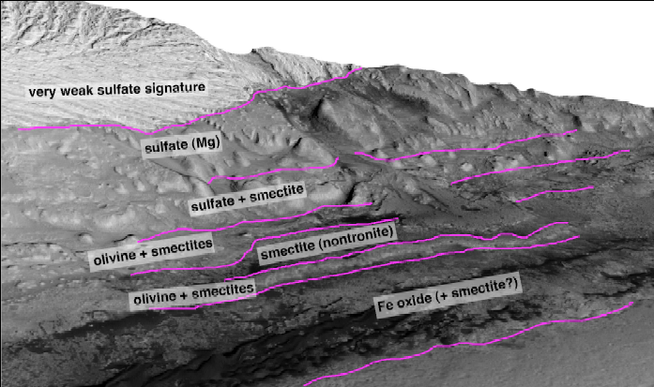
Gale Crater
Central Mound Stratigraphy
Upper Unit
Erosional unconformity
Lower Unit
Fan deposit + channel cutting lower unit

